Slide 1
CSE 417
Automata and Theory of Computation
Lecture RE
Notes:
Farazul H Bhuiyan
Lecturer
Dept. of CSE
BRAC University
Bangladesh

Slide 2
Regular Expressions
Regular expressions are an algebraic way to describe languages.
Describes exactly the regular languages.
If R is a regular expression, then L(R) is the language it defines.

Slide 3
Regular Expressions
A regular expression over an alphabet Σ is recursively defined as follows:
a denotes Regular Expression where a ∈ Σ
R₁ U R₂ is a R.E.
Where R₁ and R₂ are R.Es
Other Notation: R₁ | R₂ (‘|’ is read as OR)
R₁ o R₂ is a R.E.
Concatenation
Other Notation: R₁ R₂
R₁* is a R.E.
ε is R.E.
ø is R.E.
(R₁) is R.E.

Slide 4
Regular Expressions
Star Binds Tightest
ab* = a(b)*
!= (ab)*
Concatenation Binds Tighter Than union
ab U c = (ab) U c
!= a (b U c)
ab | c = (ab) | c
!= a (b | c)

Slide 5
Regular Expressions
Star or Closure (Zero or More Occurrences )
a* = {a}
= {a}*
Plus (One or More Occurrences)
a⁺ = aa*
= {a}⁺
Optional (One or No Occurrence)
[a] = a|ε
= (a U ε)
= a?

Slide 6
Regular Expressions
Parentheses
aa bUc aa bUc aa = ?
(aab)U(caab)U(caa)
(aab)|(caab)|(caa)
d U ab* cd* = ?
(d) U (a(b*)c(d*))
(d) | (a(b*)c(d*))

Slide 7
Regular Expressions
Each Regular Expression describes a Language.
Which Language?
L(R)=?
L(a) = {a}
L(R₁ U R₂) = L(R₁) U L(R₂)
L(R₁ o R₂) = L(R₁)o L(R₂)
L(R₁*) = L(R₁)*
L(ε) = {ε}
L(ø) = {}

Slide 8
Regular Expressions
For Σ ={a, b, c, d}
R.E. a
Language {a}
R.E. abdcd
Language {abdbd}
R.E. ab U cd = ab | cd
Language {ab, cd}
R.E. a(bUc)d = a(b|c)d
Language {abd, acd}

Slide 9
Regular Expressions
For Σ ={a, b, c, d}
R.E. ab*c
R.E. a[b]c
R.E. a(bUc)ø

Slide 10
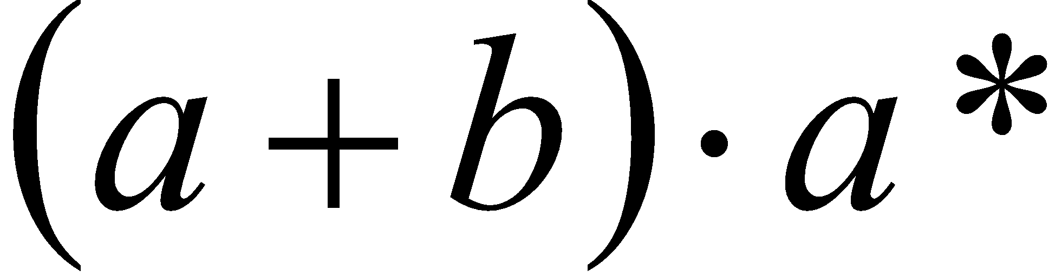

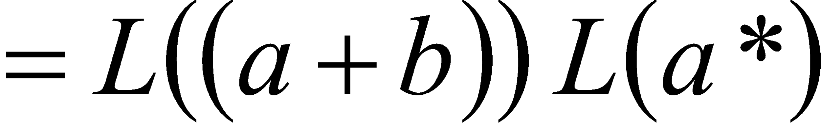
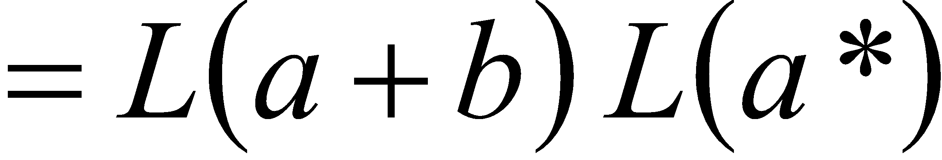
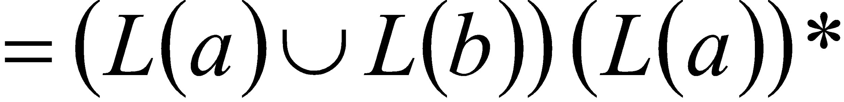
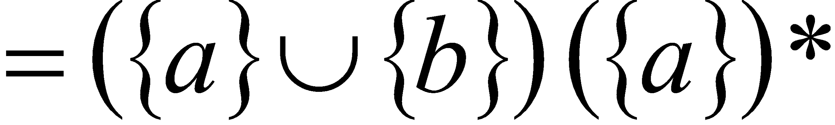
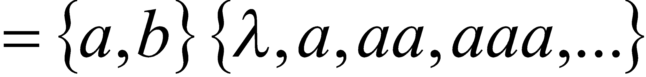
Regular Expressions
R.E.

Slide 11
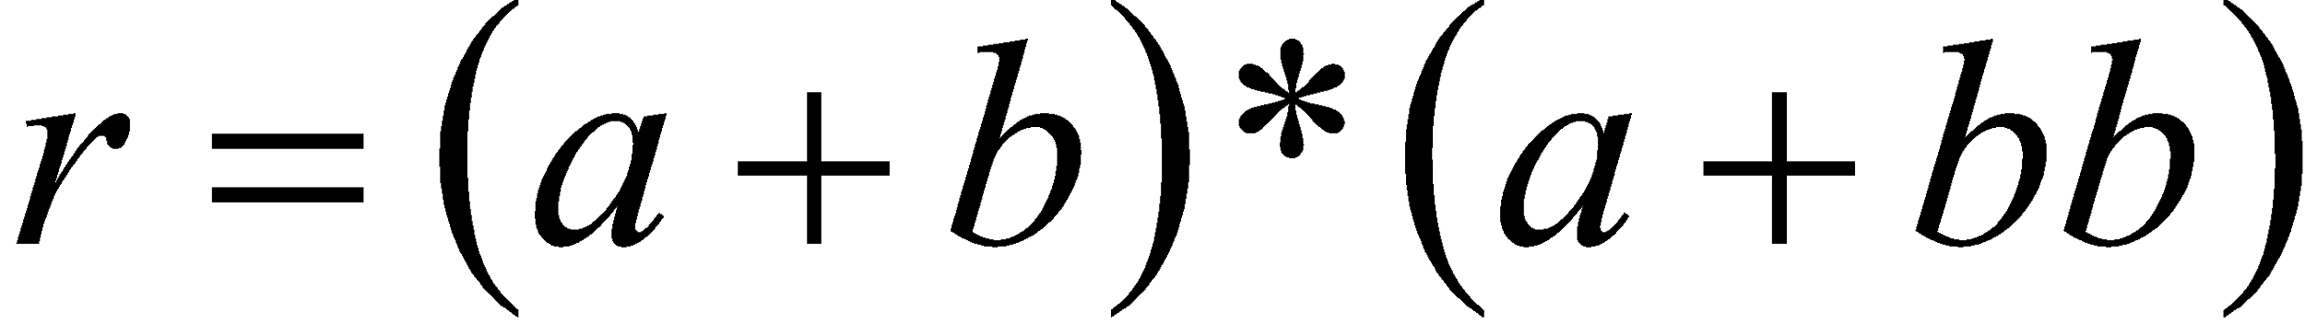
Regular Expressions
R.E.

Slide 12
Regular Expressions
What would be the R.E. to define the set of strings over {0,1} that end in 2 consecutive 1's.
R.E. (0 | 1)* 11
What would be the R.E. to define the set of strings over {0,1} that have at least one 1.
R.E. 0* 1 (0 | 1)*

Slide 13
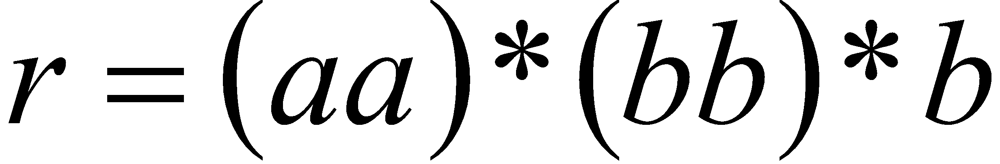
Regular Expressions
Regular expression

Slide 14
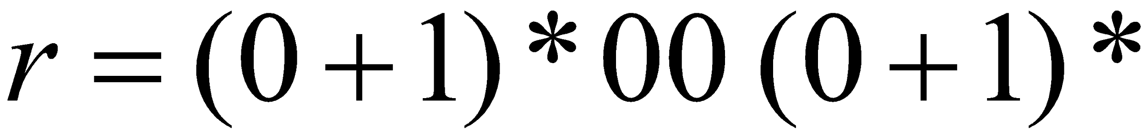
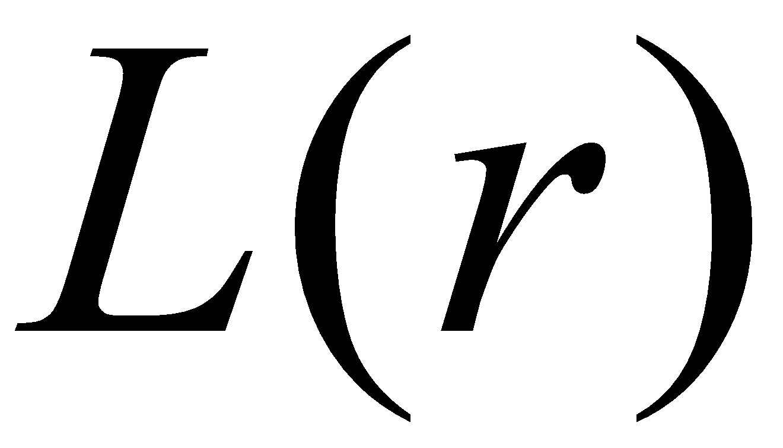
Regular Expressions
Regular expression

Slide 15
Thank You

